Slide 1
Lesson 1.4
HTML Elements/HTML Tags

Slide 2
Learning Outcomes
Recognize basic HTML Elements/HTML tags
Use the heading elements
Use horizontal rule
Use HTML elements/tags to format a piece of text
Create ordered or unordered lists

Slide 3
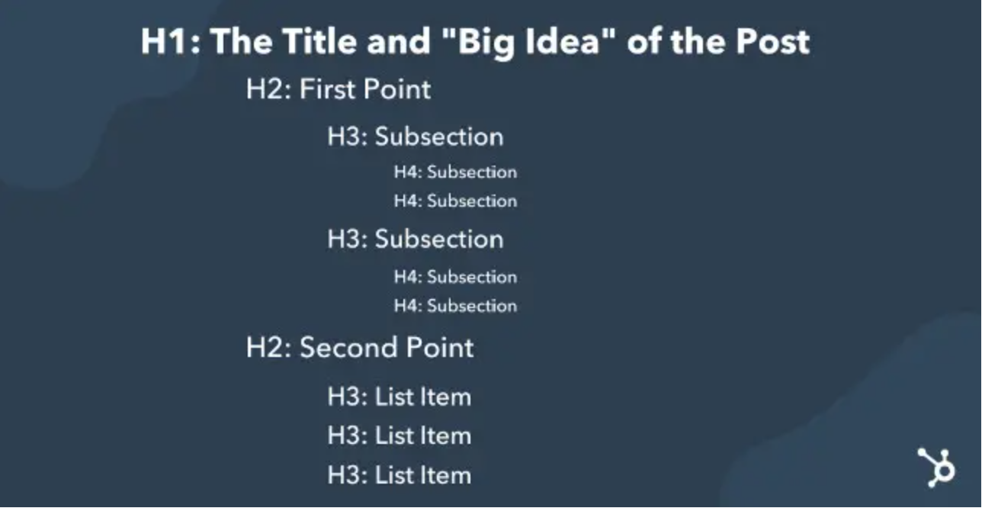
Common HTML Elements
Headings
Use <h1> to <h6> elements only for headings. Do not use them just to make text bold or big.
Use to separate headings and subheadings.
They rank in order of importance (h1 to h6) with h1 usually being the title.
Best practices:
Use one and only one h1 per page
Use heading tags in ascending order on a page.
Notes:
CodePen: HTML Headings
Why use headings tags in the proper order?
Accessbility
Improves SEO of a webpage

Slide 4
Common HTML Elements
Content
<p></p>
Represents a paragraph
<img>
Embeds an image into the document
<a></a>
Anchor tag.
Creates a hyperlink to web pages, files, email addresses, locations within the current page, or anything else a URL can address.
<em></em>
Marks text that has stress emphasis
<strong></strong>
Indicates text that have strong importance, seriousness, or urgency

Slide 5
Common HTML Elements
Organization
<div></div>
Content Division element.
Generic container for flow content. It has no effect on the content or layout until styled.
<span></span>
Content Span element.
Generic inline container for phrasing content. It can be used to group elements for styling purposes.
<hr>
Horizontal Rule
<br>
Line Break

Slide 6
HTML Elements – Block and Inline
Two categories of elements: Block vs Inline
Block:
Creates the structure of the document
Takes up 100% of the space available
Examples: <div>, <p>, <h1>…<h6>, <form>, <ol>, <ul>, <li>
Inline
Stylizes the contents of a block
Takes up as much space as required
Examples: <img>, <a>, <span>, <strong>, <em>, <button>, <input>
Notes:
CodePen: Block vs Inline

Slide 7
HTML Elements – Lists
3 types of lists:
Unordered
Used to create a bulleted list.
Ordered
Used to create a numbered list.
Description
Used to create a list of term-description pairs.
Can be nested
Can contain other elements
Notes:
The description list (<dl>) is used to create a list of term-description pairs. Each term is represented by <dt> (definition term), and each description is represented by <dd> (definition description).
CodePen: HTML Lists

Slide 8
Learning Activity 1.4.1
“Create an HTML Cover Page”

Slide 9
Learning Activity 1.4.2
“Create Text Formatting and Lists”

Slide 10
Line Indentation
The next two blocks of code produce exactly the same output.
Which one is easier to read?

Slide 11
Notes:
<!DOCTYPE html><html><head><title>Sample Page</title></head><body><header><h1>Welcome to My Page</h1></header><nav><ul><li><a href="#">Home</a></li><li><a href="#">About</a></li><li><a href="#">Contact</a></li></ul></nav><main><section><h2>About Us</h2><p>This is a brief description of our website.</p></section><section><h2>Contact Information</h2><p>You can contact us at example@email.com.</p></section></main><footer><p>&copy; 2023 My Page</p></footer></body></html>

Slide 12
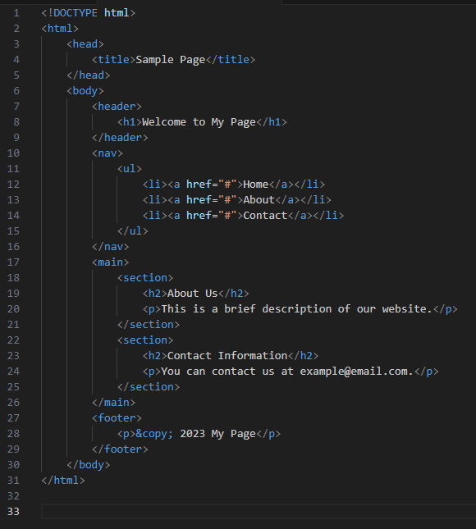
Notes:
<!DOCTYPE html>
<html>
<head>
<title>Sample Page</title>
</head>
<body>
<header>
<h1>Welcome to My Page</h1>
</header>
<nav>
<ul>
<li><a href="#">Home</a></li>
<li><a href="#">About</a></li>
<li><a href="#">Contact</a></li>
</ul>
</nav>
<main>
<section>
<h2>About Us</h2>
<p>This is a brief description of our website.</p>
</section>
<section>
<h2>Contact Information</h2>
<p>You can contact us at example@email.com.</p>
</section>
</main>
<footer>
<p>&copy; 2023 My Page</p>
</footer>
</body>
</html>

Slide 13
Line Indentation
Always use line indentation while coding
More easily readable
Helps you and other developers easily understand the structure of your code
Good practice for maintaining clean code
Prevents bugs
I expect your submitted code to be properly indented

Slide 14
Comments
Why do we use comments?
Comments in HTML
Starts with: <!--
Ends with: -->
Can go on multiple lines
Ask yourself: does this code need further explanation?
I expect your submitted code to be properly commented.

Slide 15
Excellent Resources
HTML elements dictionary
https://devdocs.io/html-elements/
Stack overflow – Q&A
https://stackoverflow.com/
Example: “How do I open a link in a new tab in HTML?”
Random text generator
https://www.lipsum.com/

Slide 16
For next class
Read Lesson 1.5
Do Learning Activity 1.5.1
Assessments Reminder:
Engagement is worth 10% of your final grade. Engage by sharing code, asking or answering questions, etc.
All assessment dates have been posted in the D2L calendar.
See the “Assignments Policy” for late submission procedures.

Slide 17
References
https://www.w3schools.com/tags/tag_hn.asp
https://developer.mozilla.org/en-US/docs/Web/HTML/Element
https://blog.hubspot.com/marketing/header-tags

